Slide 1

THE STUDY ON CUSTOMER SATISFICATION TOWARDS MOBILE USAGE IN VIRUDHUNAGAR
Project report submitted to V.H.N. Senthikumara Nadar College (Autonomous), Virudhunagar, in partial fulfilment of the requirements for the Degree of “Bachelor of Commerce with Computer Application”
By
P. VISHNU (21SUCC094)
V. YUVA RAJ (21SUCC095)
Under the Guidance of
Ms. SHUNMATHY V
M.com., M.Phil.,
Assistant Professor, Department of Commerce (CA) SF
V.H.N. Senthikumara Nadar College (Autonomous)

Slide 2
abstract
Customers are becoming more dependable on the smart phones. Nowadays people seems to become more dependent towards smartphone due to its convenience, reliability, durability, adorable camera features, fast installation of various apps and the most important factor is that it can do entire functions that computer performs. The major objective of this research study undertakes on identifying the various brands of smartphones that are preferred by the customers to analyze the satisfaction level of customers towards smartphone usage. These applications include but are not limited to: audio, web browsing, video gaming, texting, and video streaming. The industry is keen on producing lighter devices with an ever-increasing data rates and computing demands, and the race to satisfy consumers appetite will no doubt continue to escalate. The study covers customer satisfaction towards smartphone usage. This survey is conducted in Virudhunagar City. The study based on primary data.
Key words: Smartphone, Users and satisfaction levels.

Slide 3
INTRODUCTION
Nowadays the trend of having smartphone has taken place at the great extent. Each and every consumer is looking for various brands of smartphone in order to analyze and compare which would be more compatible in terms of design, quality, pricing, advance technology etc. Apple is the type of company which understands what the customers actually prefer and also the future aspects of the innovation in such a manner that no other company thinks to do. There are various other models of smartphone such as samsung, redmi, oppo, vivo, which are also fulfilling the expectation of customer base and are mostly preferred by the medium income section of customer base. In the recent years it was shown that 65-70% of the world’s population own at least one smartphone. In Today’s Scenario most of the consumers are looking towards buying more technological and advanced smartphone. Therefore, the consumers belonging to higher or medium income group are preferring a reliable smart phone for their long-term usage maybe their preference would be different regarding choosing of models depending on pricing structure. As Apple costs premium pricing than other smart phones therefore only higher section of the society thinks about purchasing iPhone rest of the consumers who can’t afford premium pricing go towards Samsung, Redmi etc. Samsung is also one of the trusted and loyal smart phones preferred by one third of the population because of its long-term durability. India has the fastest-growing smartphone market in the world, everybody looks India as a huge landing ground for their innovation therefore the Indian market has huge competition and thus its necessary to understand the customer perception in order to satisfy their requirements in long run. Customer satisfaction plays a crucial factor in terms of finding whether the customer is preferring the particular model of smartphone or switching towards other models due to some gaps which can be battery issues, network issues etc. Therefore, to overcome this issue various companies are taking the feedback in order to keep their customer base retained for longer time period.

Slide 4
Objectives of study
To analyze the factors influenced while purchasing mobile phones.
To analyze the customer satisfaction level towards usage of mobile phones.
To explore the problems faced by the customers in usage of mobile phones.
To offer solution regarding the problems faced by the customers in usage of mobile phones.

Slide 5
Research design and methodology
In view of considerable data-from survey research, secondary sources also collected and presented in this research report. framing of the questionnaire and the evaluation of the data collected have been designed accordingly. The suggestions of the study emerge from the inferences drawn from the sample survey of Mobile Usage customers in Virudhunagar.

Slide 6
Limitation of the study
The present study is limited its scope to Virudhunagar only. Hence the findings of the study may not be generalized to the big cities at the national level.
Due to time constraint, the number of respondents was limited.
There are chances of personal bias in convenient sampling technique used in this study. It may influence the findings of the study.
As this study is a descriptive one, it has not analyzed the problem in depth by testing on experimental bias.

Slide 7
THE STUDY ON CUSTOMER SATISFICATION TOWARDS MOBILE USAGE IN VIRUDHUNAGAR
PRIMARY DATA
SECONDARY DATA
The present study is an empirical one based on survey method. First-hand data are collected from the fields through questionnaire and observation. A well-structured questionnaire has been prepared in consultation with the research guide.
The questionnaire has been used for collecting the required data for the Mobile Usage. Data relating to the customer satisfaction towards Mobile Usage in Virudhunagar are gathered through questionnaire.
Secondary data are also collected for this study. Apart from the primary data, the secondary data for the present study was collected from standard text books of related topics, leading journals, published documents and sources from internet.

Slide 8
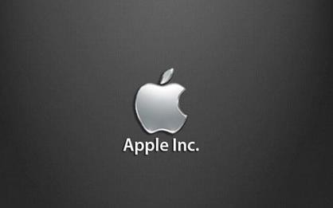
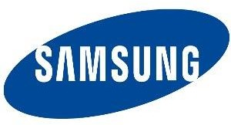
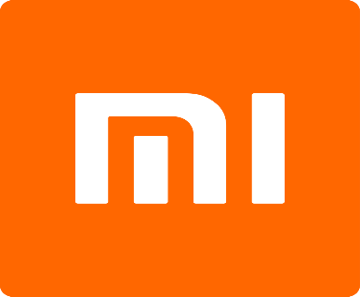

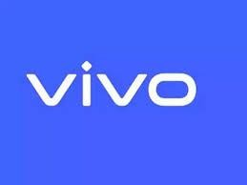


List of MOBILE brands are used in OUR project
I PHONE
SAMSUNG
REDMI
ONEPLUS
VIVO
OPPO
REALME

Slide 9
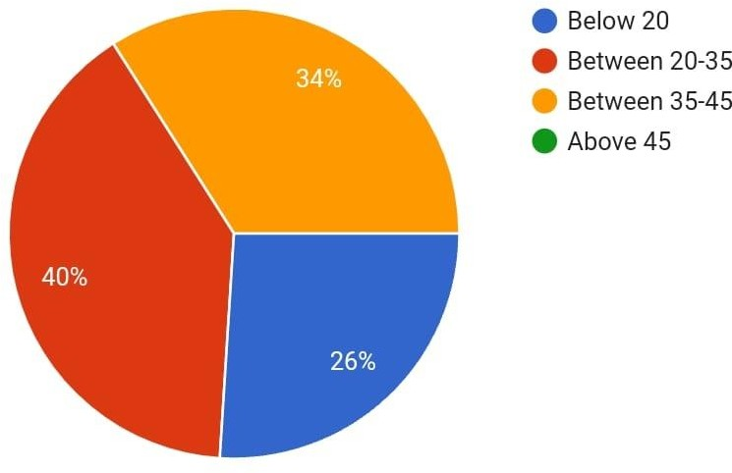
Analysis AGE of the respondents
S. NO | AGE | NO OF RESPONDENTS | PERCENTAGE
1 | BELOW 20 | 13 | 26
2 | BETWEEN 20-35 | 20 | 40
3 | BETWEEN 35-45 | 17 | 34
4 | ABOVE 45 | 0 | 0
TOTAL |  | 50 | 100
INFERENCE
Highest 40% of the respondents are between 20 – 35.

Slide 10
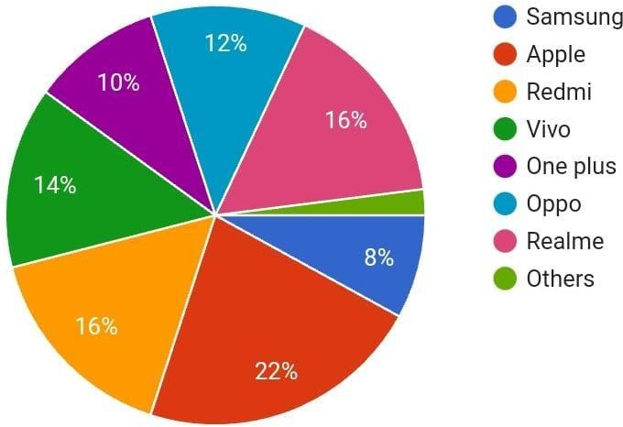
BRAND OF MOBILE YOU USE
S.NO | PARTICULARS | NO OF RESPONDENTS | PERCENTAGE
1 | SAMSUNG | 4 | 8
2 | APPLE | 11 | 22
3 | REDMI | 8 | 16
4 | VIVO | 7 | 14
5 | ONEPLUS | 5 | 10
6 | OPPO | 6 | 12
7 | REALME | 8 | 16
8 | OTHERS | 1 | 2
TOTAL |  | 50 | 100
INFERENCE
Majority 22% of the respondents use apple brand.

Slide 11
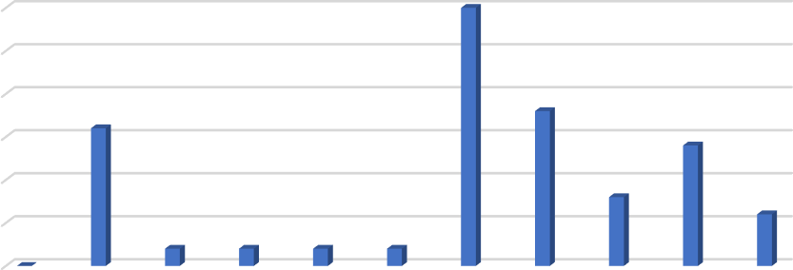

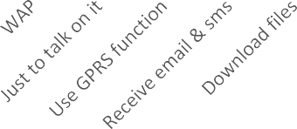


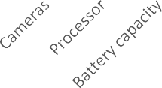
Reasons for using this mobile
S. NO | PARTICULARS | NO OF RESPONDENTS | PERCENTAGE
1 | WAP | 8 | 16
2 | JUST TO TALK ON IT | 1 | 2
3 | USE GPRS FUNCTION | 1 | 2
4 | RECEIVE EMAIL&SMS | 1 | 2
5 | DOWNLOADING FILES | 1 | 2
6 | GAMING | 15 | 30
7 | MOVIES | 9 | 18
8 | CAMERAS | 4 | 8
9 | PROCESSOR | 7 | 14
10 | BATTERY CAPACITY | 3 | 6
TOTAL |  | 50 | 100
30
25
20
15
10
5
0
INFERENCE
Majority 30% of the respondents are use for gaming
purpose.

Slide 12
Factors influenced to use mobile phone
S. NO | PARTICULARS | NO OF RESPONDENTS | PERCENTAGE
1 | PRICE | 5 | 10
2 | BRAND | 10 | 20
3 | COLOR | 7 | 14
4 | DESIGN | 4 | 8
5 | FEATURES | 13 | 26
6 | USERS FRIENDLY | 7 | 14
7 | FAMILY&FRIENDS | 4 | 8
TOTAL |  | 50 | 100
Factors influenced
Price
Brand
Color
Design Features
Users Friendly Family & Friends
INFERENCE
Majority 26% of the respondents are influenced by features.

Slide 13
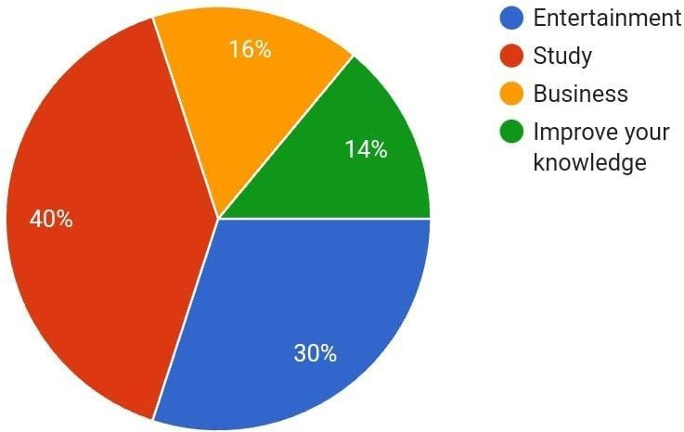
Preference to use while using internet on your mobile phone
S. NO | PARTICULARS | NO OF RESPONDENTS | PERCENTAGE
1 | ENTERTAINMENT | 15 | 30
2 | STUDY | 2O | 40
3 | BUSINESS | 8 | 16
4 | IMPROVE KNOWLEDGE | 7 | 14
TOTAL |  | 50 | 100
INFERENCE
Majority 40% of the respondents prefer to use study purpose.

Slide 14
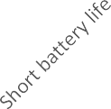
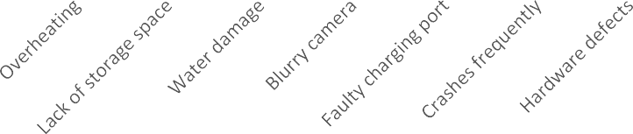
Problems faced by the respondents using mobile
S. NO | PARTICULARS | NO OF RESPONDENTS | PERCENTAGE
1 | Short battery life | 9 | 18
2 | Over heating | 14 | 28
3 | Lack of storage space | 7 | 14
4 | Water damage | 3 | 6
5 | Blurry camera | 7 | 14
6 | Faulty charging port | 2 | 4
7 | Crashes frequently | 5 | 10
8 | Hardware defects | 3 | 6
TOTAL |  | 50 | 100
30
25
20
15
10
5
0
INFERENCE
MAJORITY 28% OF THE RESPONDENTS FACE PROBLEM LIKE OVERHEATING

Slide 15
SUGGESTIONS
There is a wide scope for further development of mobile phone.
They should get the feedback report from the customer in order to fulfil the customer needs and wants.
Overheating issue should be improved as well.
Most of the people suggest to introduce more features. Expect cost reduction.

Slide 16
CONCLUSION
Most of them are using mobile phones to access the web, download apps, especially as Smartphone ownership grows. And because they would expect to get information quickly via mobile. The technology of mobile phone has developed so much which brings the world to our fingers. This study has given an overall analysis of the customer satisfaction towards using of Smart phones.

Slide 17

THANK YOU

